Slide 1


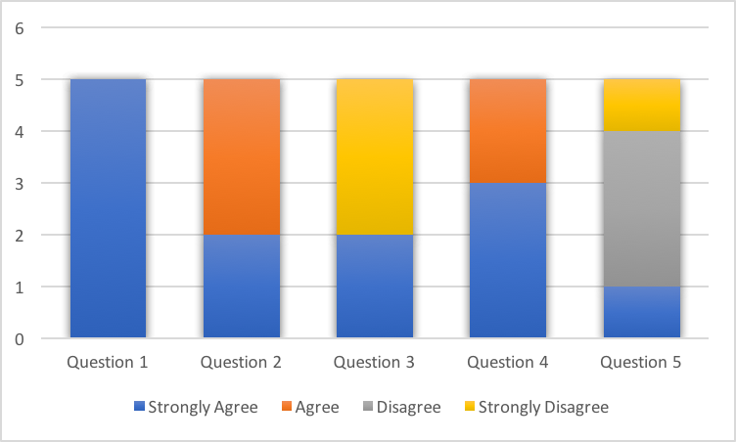


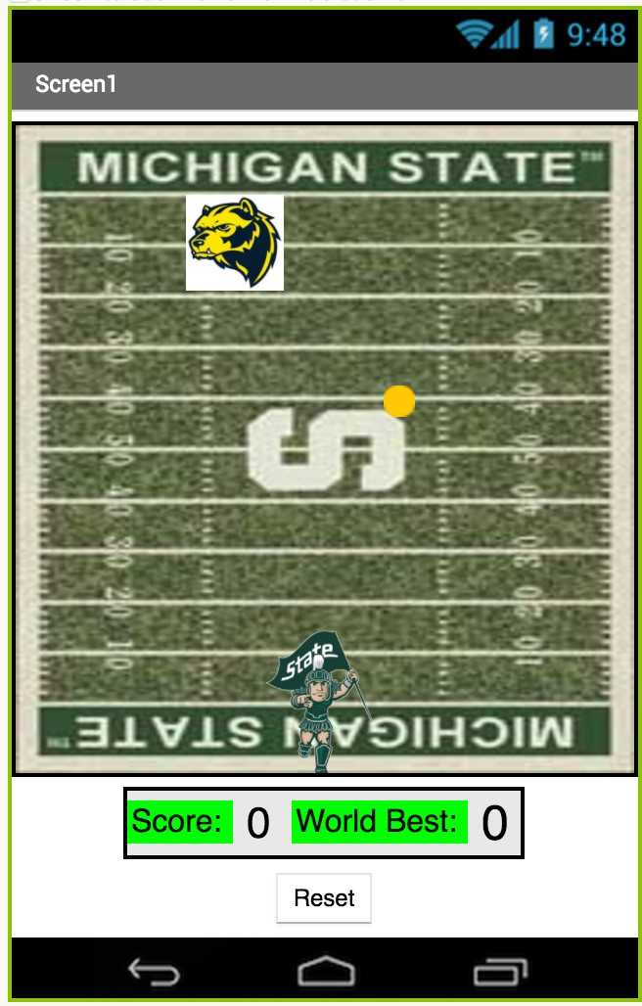
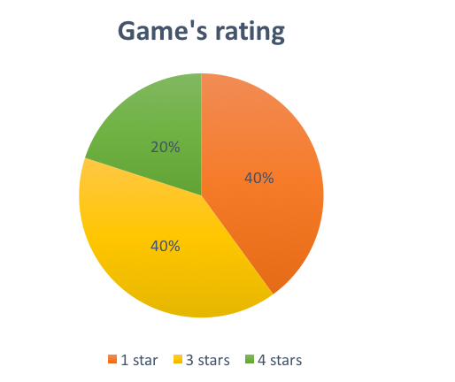
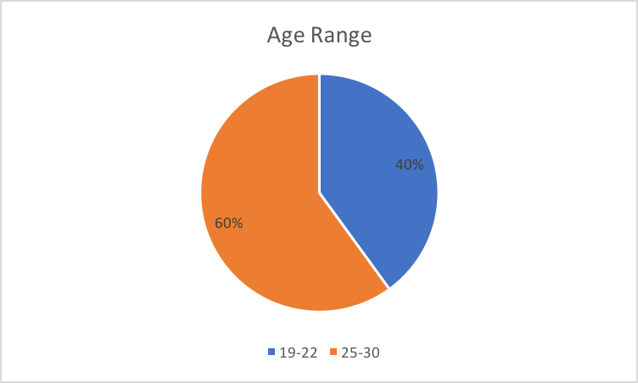

FREE SPARTAN ATTACK APP GAME
Kelsee Horrom¹, Yue Wang², Renjie Chen³, Essam Aljahmi ⁴
EGR 100 Summer Session Section 101 Professor: Mr. Hinds TA: Roya Solhmirzaei
Michigan State University, East Lansing, MI
Introduction
Results
Conclusions
In society, people use technology every day in some way, an example is entertainment. This can benefit the society because for the user, it saves money, time and it is convenient. It saves money because the user does not have to buy a console such as an Xbox or Playstation to play specific types of games. It saves time because it is on the person’s device which is usually near the person at all times making it also convenient.
With this in mind, the objective is to use the MIT App Inventor to create a free Android game based on the MSU campus. The game contains graphical user interface (GUI) with images, a professional appearance, and outputs of sound. Other capabilities the game has storage of user information such as a high score and animation.
The concept prototyped involves having the player which is Sparty run horizontally on the field. When tapped, Sparty will throw a ball to hit the Wolverine on the opposite end of the field. The Wolverine is moving back and forth randomly while Sparty has to defend his End Zone on the field.
Figure 1 demonstrates the answers of the five participants. The questions asked were: 1. Are the directions easy to follow? 2. Is it easy to play the game? 3. Do you like the other college’s mascot picture? 4. Do you like the sounds present? 5. Do you like the background of the game?
Figure 1: Results of the Survey
Figure 2 has what the participants think the game rating should be through star ratings.
Figure 3 is the age ranges of the participants.
Equation for score is as follows:
$$\frac{1}{total time the user is in the game}×successful attacks=score$$
The equation to keep a global high score is through the TinyWebDB in the MIT App Inventor [2]. Through the MIT App Inventor TinyWebDB has the players connect to the internet and shows the six highest score values to the player. Equation is as follows: [“VALUE”, “Hi_Score”, “6”].
Spartan Attack needs improvements in the future to make it a 4 or 5 star rating game instead of mostly 1 or 3 stars in Figure 2.
In addition broadening the range of ages in the future for testing to see what different generations think of the game for more improvements. Also surveying more people.
What Spartan Attack does well is have easy game directions, easy game play, and sounds seen in Questions 1, 2, and 4 in Figure 1.
Future improvements include making the other mascot’s picture more realistic while having a clear background so it blends in, seen in Question 3 in Figure 1 and Figure 6.
Also could change the background picture of the In-Game Screen to match the End Zones the mascot represents, for example in Figure 6, instead of Michigan State it could say U of M.
Methods and Materials
Materials: MIT App Inventor, Android phone, and time.
First was to practice using the MIT App Inventor through tutorials that were provided on the website.
Then start programming Spartan Attack with the ideas from Space Invaders [1].
Use Photoshop for pictures of Sparty, U of M Wolverine, and the football fields for the backgrounds.
Make three screens with sound for the Figure 4: Home Screen, Figure 5: Directions Screen and Figure 6: In-Game Screen.
On the bottom of the In-Game Screen there is the player’s score and global high score [2] which is the highest score out of all the players.
After making the game there needed to be a way to see for any improvements by making a short survey.
Five random participants were chosen to play the prototype.
The survey consisted of seven questions.
Five main questions had the options-strongly agree, agree, disagree and strongly disagree.
The other two were rating of the game in stars and age of the participants.
Figure 2: The Game’s Rating with Stars
Figure 3: Age Group of Participants
Figure 4: Main Screen of the Game
Figure 5: Directions of the Game
Figure 6: In-Game Screen with the Score and Best Score
References
MIT App Inventor. Space Invaders. Massachusetts Institute of Technology, 1 Jan. 2012. Web. Accessed 09 June 2017. http://appinventor.mit.edu/explore/ai2/space-invaders.html.
App Inventor Teacher. (2015, January, 2). App Inventor 2 Tutorial - Keeping a Global High Score (Part 1) https://www.youtube.com/watch?v=Y81FiJvUPzA.
Notes:
In the results section figure1 shows the answers 5 main questions Players connect to the internet and shows the 6 highest score values to the players through equation:
1

